Slide 1
A Modified Definition of Sov, a Segment-
Based Measure for Protein Secondary
Structure Prediction Assessment
Adam Zemla, Ceslovas Venclovas, Krzysztof Fidelis, and Burkhard Rost
PROTEINS: Structure, Function, and Genetics 34:220–223 (1999)
Presenter: Chong-Han Chiang
Date: Sept, 28, 2006

Slide 2
ABSTRACT
We present a measure for the evaluation of secondary structure prediction methods that is based on secondary structure segments rather than individual residues.
The algorithm is an extension of the segment overlap measure Sov, originally defined by Rost et al. (J Mol Biol 1994;235:13–26).
The new definition of Sov corrects the normalization procedure and improves Sov’s ability to discriminate between similar and dissimilar segment distributions.
The method has been comprehensively tested during the second Critical Assessment of Techniques for Protein Structure Prediction (CASP2).
Here, we describe the underlying concepts, modifications to the original definition, and their significance.
Proteins 1999;34:220–223. Published 1999Wiley-Liss, Inc.†

Slide 3
INTRODUCTION
The secondary structure of proteins has long been predicted and analyzed on a per residue basis.
Methods: Q3, Sov, New Sov.
Q3, the the traditional per-residue measure, defined as a fraction of residues predicted correctly in three conformational states.
Even for homologous protein pairs with very similar
sequences, elements of secondary structure frequently differ in the exact position of their ends. Thus, it is sometimes difficult to make an unequivocal
conformational assignment, especially at segment ends.
Sov, it has been able to effectively capture structurally important features (secondary structure segments) and to reduce the significance of those that are structurally less important (small variation of segment length and position).

Slide 4
DEFINITION OF THE NEW MEASURE
we give the definition for three-state assignments: helix (H), strand (E), and other, i.e. non-regular structure, which for historical reasons is being referred to as coil (C)
We will use s1 and s2 to denote segments of secondary structure in conformational state i (i.e. H, E, or C). Segments s1 and s2 correspond to the two secondary structure assignments being compared. The first assignment is considered a reference and is typically based on experiment, the second is the one being evaluated.

Slide 5

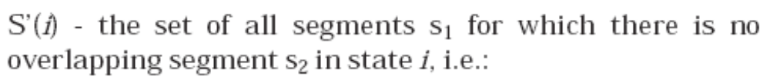

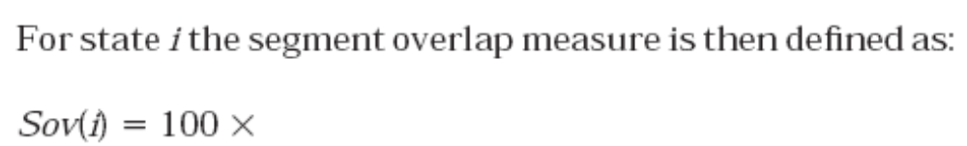
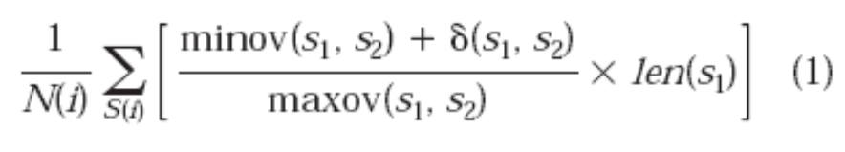

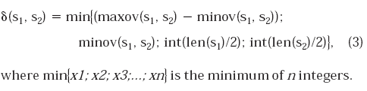
S (i):
S’ (i):
Sov (i):
N (i):
δ (s1,s2):

Slide 6

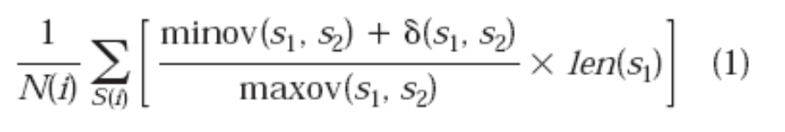
Sov (i) :
N (i):
The sum in Eq. 1 and the first sum in Eq. 2 are taken over
all the segment pairs in state i which overlap by at least
one residue, the second sum in Eq. 2 is taken over the
remaining segments in state i found in the reference
assignment, len(s1) is the number of residues in segment
s1, minov(s1,s2) is the length of the actual overlap of s1 and
s2, i.e. for which both segments have residues in state i,
maxov(s1,s2) is the total extent for which either of the
segments s1 and s2 has a residue in state i.

Slide 7
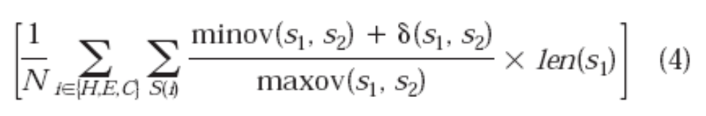
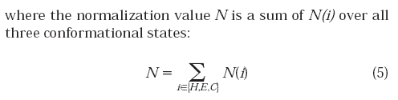
Sov :
N :
Sov values always are within range 0–100 and thus can be used in percentage scale to allow direct comparison with other prediction evaluation measures, for example Q3.

Slide 8
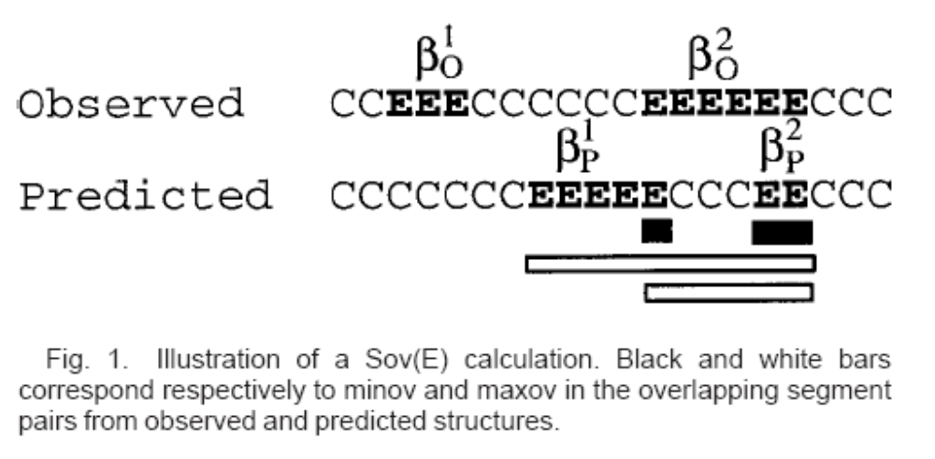
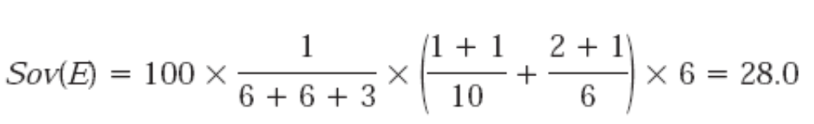
In the observed structure the first strand bO1 belongs to the set S’(E) because it does not produce any overlapping pair, the second strand produces two of them: (bO2, bP1) and (bO2, bP2).
Sov (E):

Slide 9
Sov observed v.s Sov prediction
the easiest way to understand the relationship between these two measures is to analyze the prediction success for one particular conformational state.
It should be noted that for segments as well as for individual residues ‘‘fraction correct of predicted’’19 can be indicative of the method’s predictive power only if it is used together with ‘‘fraction correct of observed.’’

Slide 10
PROPERTIES OF THE NEW MEASURE
The new measure preserves the basic concepts of Sov’94, however it differs in two important respects: the normalization procedure and the definition of δ , a degree of variation allowed at the segment edges.
the normalization procedure lowers the prediction score for both erroneous partitioning and non-prediction of segments.
δcan never exceed one-half of the shorter segment.
Although without the δ extension (δ=0) Sov gives adequate results for distinguishing between poor and successful predictions, it completely ignores the natural variation at the edges of secondary structure segments.

Slide 11
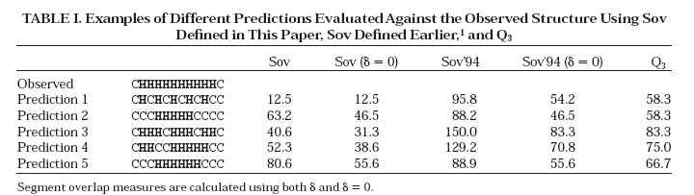
Predictions 1 and 2 show that the new Sov can effectively discriminate between unrealistic and quite accurate predictions while Q3 fails.
this example demonstrates that in some cases the original Sov produces values outside the 0–100% range.

Slide 12
RESULT
Assignment of secondary structure provides a relatively simple structural characterization of a protein. Even so, consistency with the tertiary structure is an important issue, one that should be addressed in prediction assessment.
In this respect, the re-defined segment-based Sov provides an assessment of prediction quality that is clearly superior to a residue-based approach, such as Q3.
First, they provide evaluation that is free from human bias, second they can be directly used in methods development, as well as other tasks requiring extensive evaluation.

